Slide 1
What you crave, shapes you.
What you chase, creates you.

Slide 2

Your messages,
Your comments,
Your constant push
For so many days
have not gone unheard!

Slide 3

It’s because of YOU that we’re finally back.
THE WAIT IS OVER.
The product you've been asking for...
Is ready to high

Slide 5
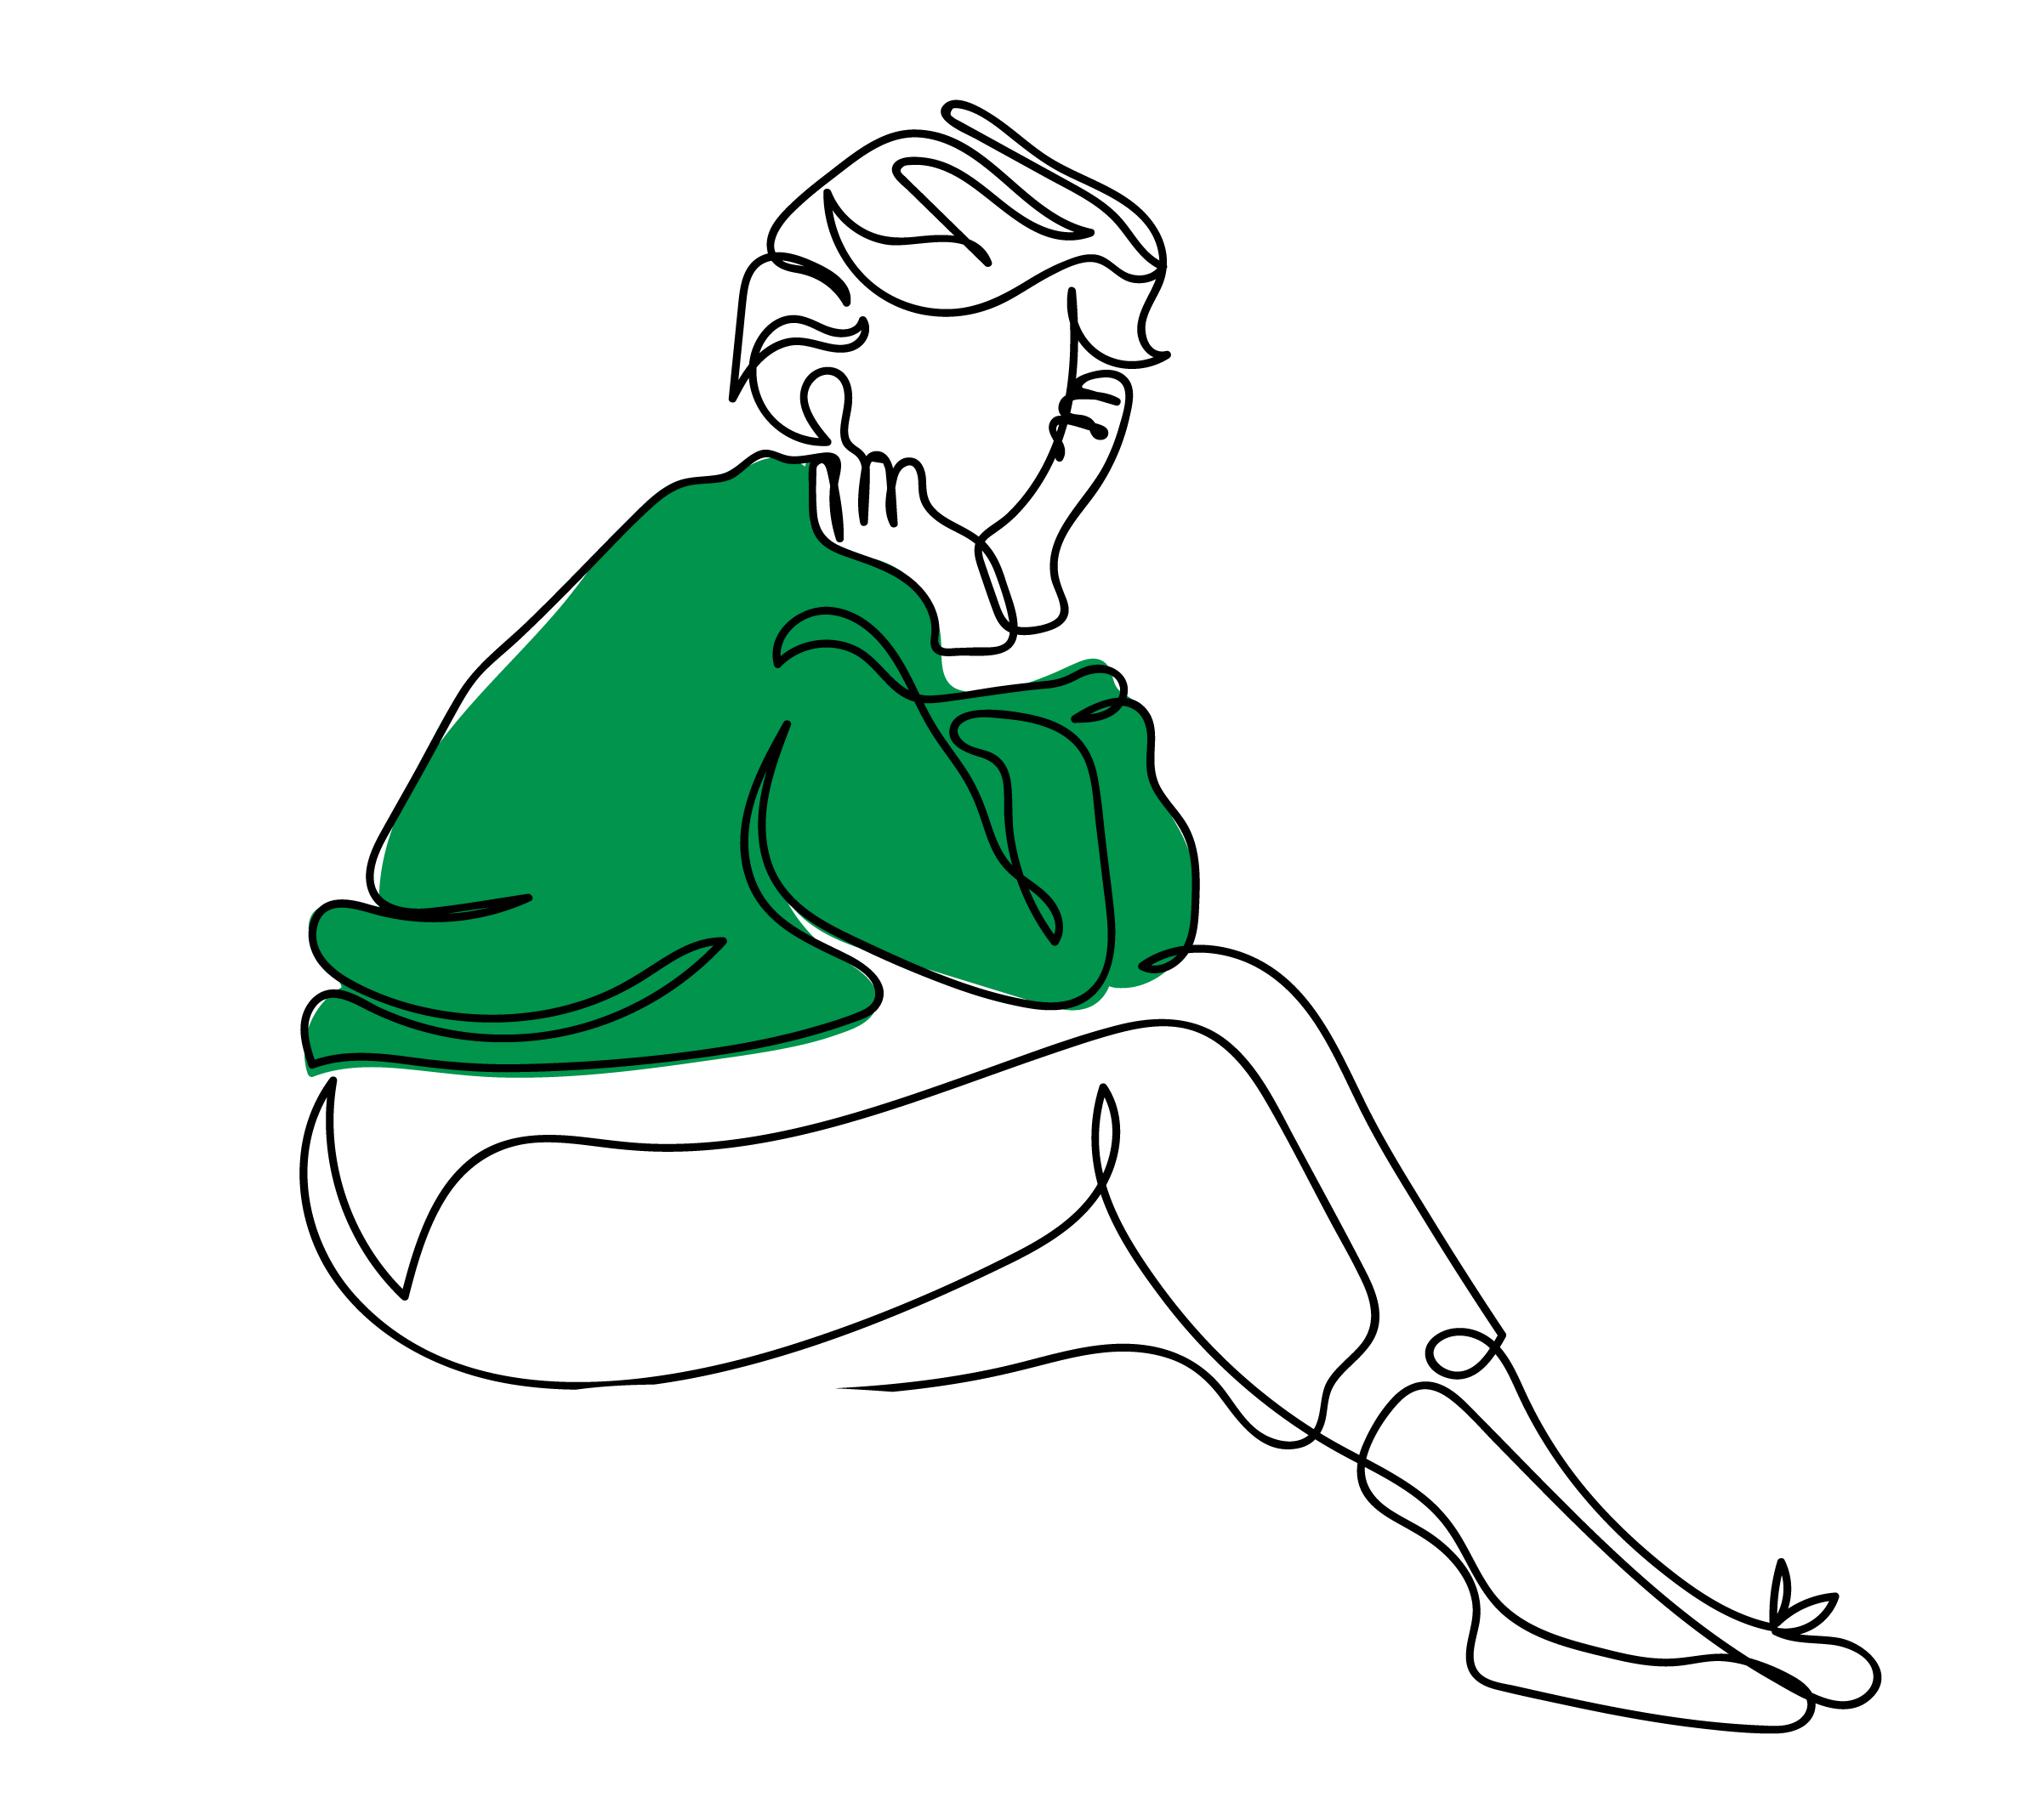

Every woman knows those moments
When the fear of stains, discomfort, or just
not feeling like yourself takes away your confidence.
Where every step was taken carefully.
Where every smile was guarded.
Where periods don’t just come with cramps —
they come with uncertainty.
But, being a woman means
RISING above it.

Slide 6

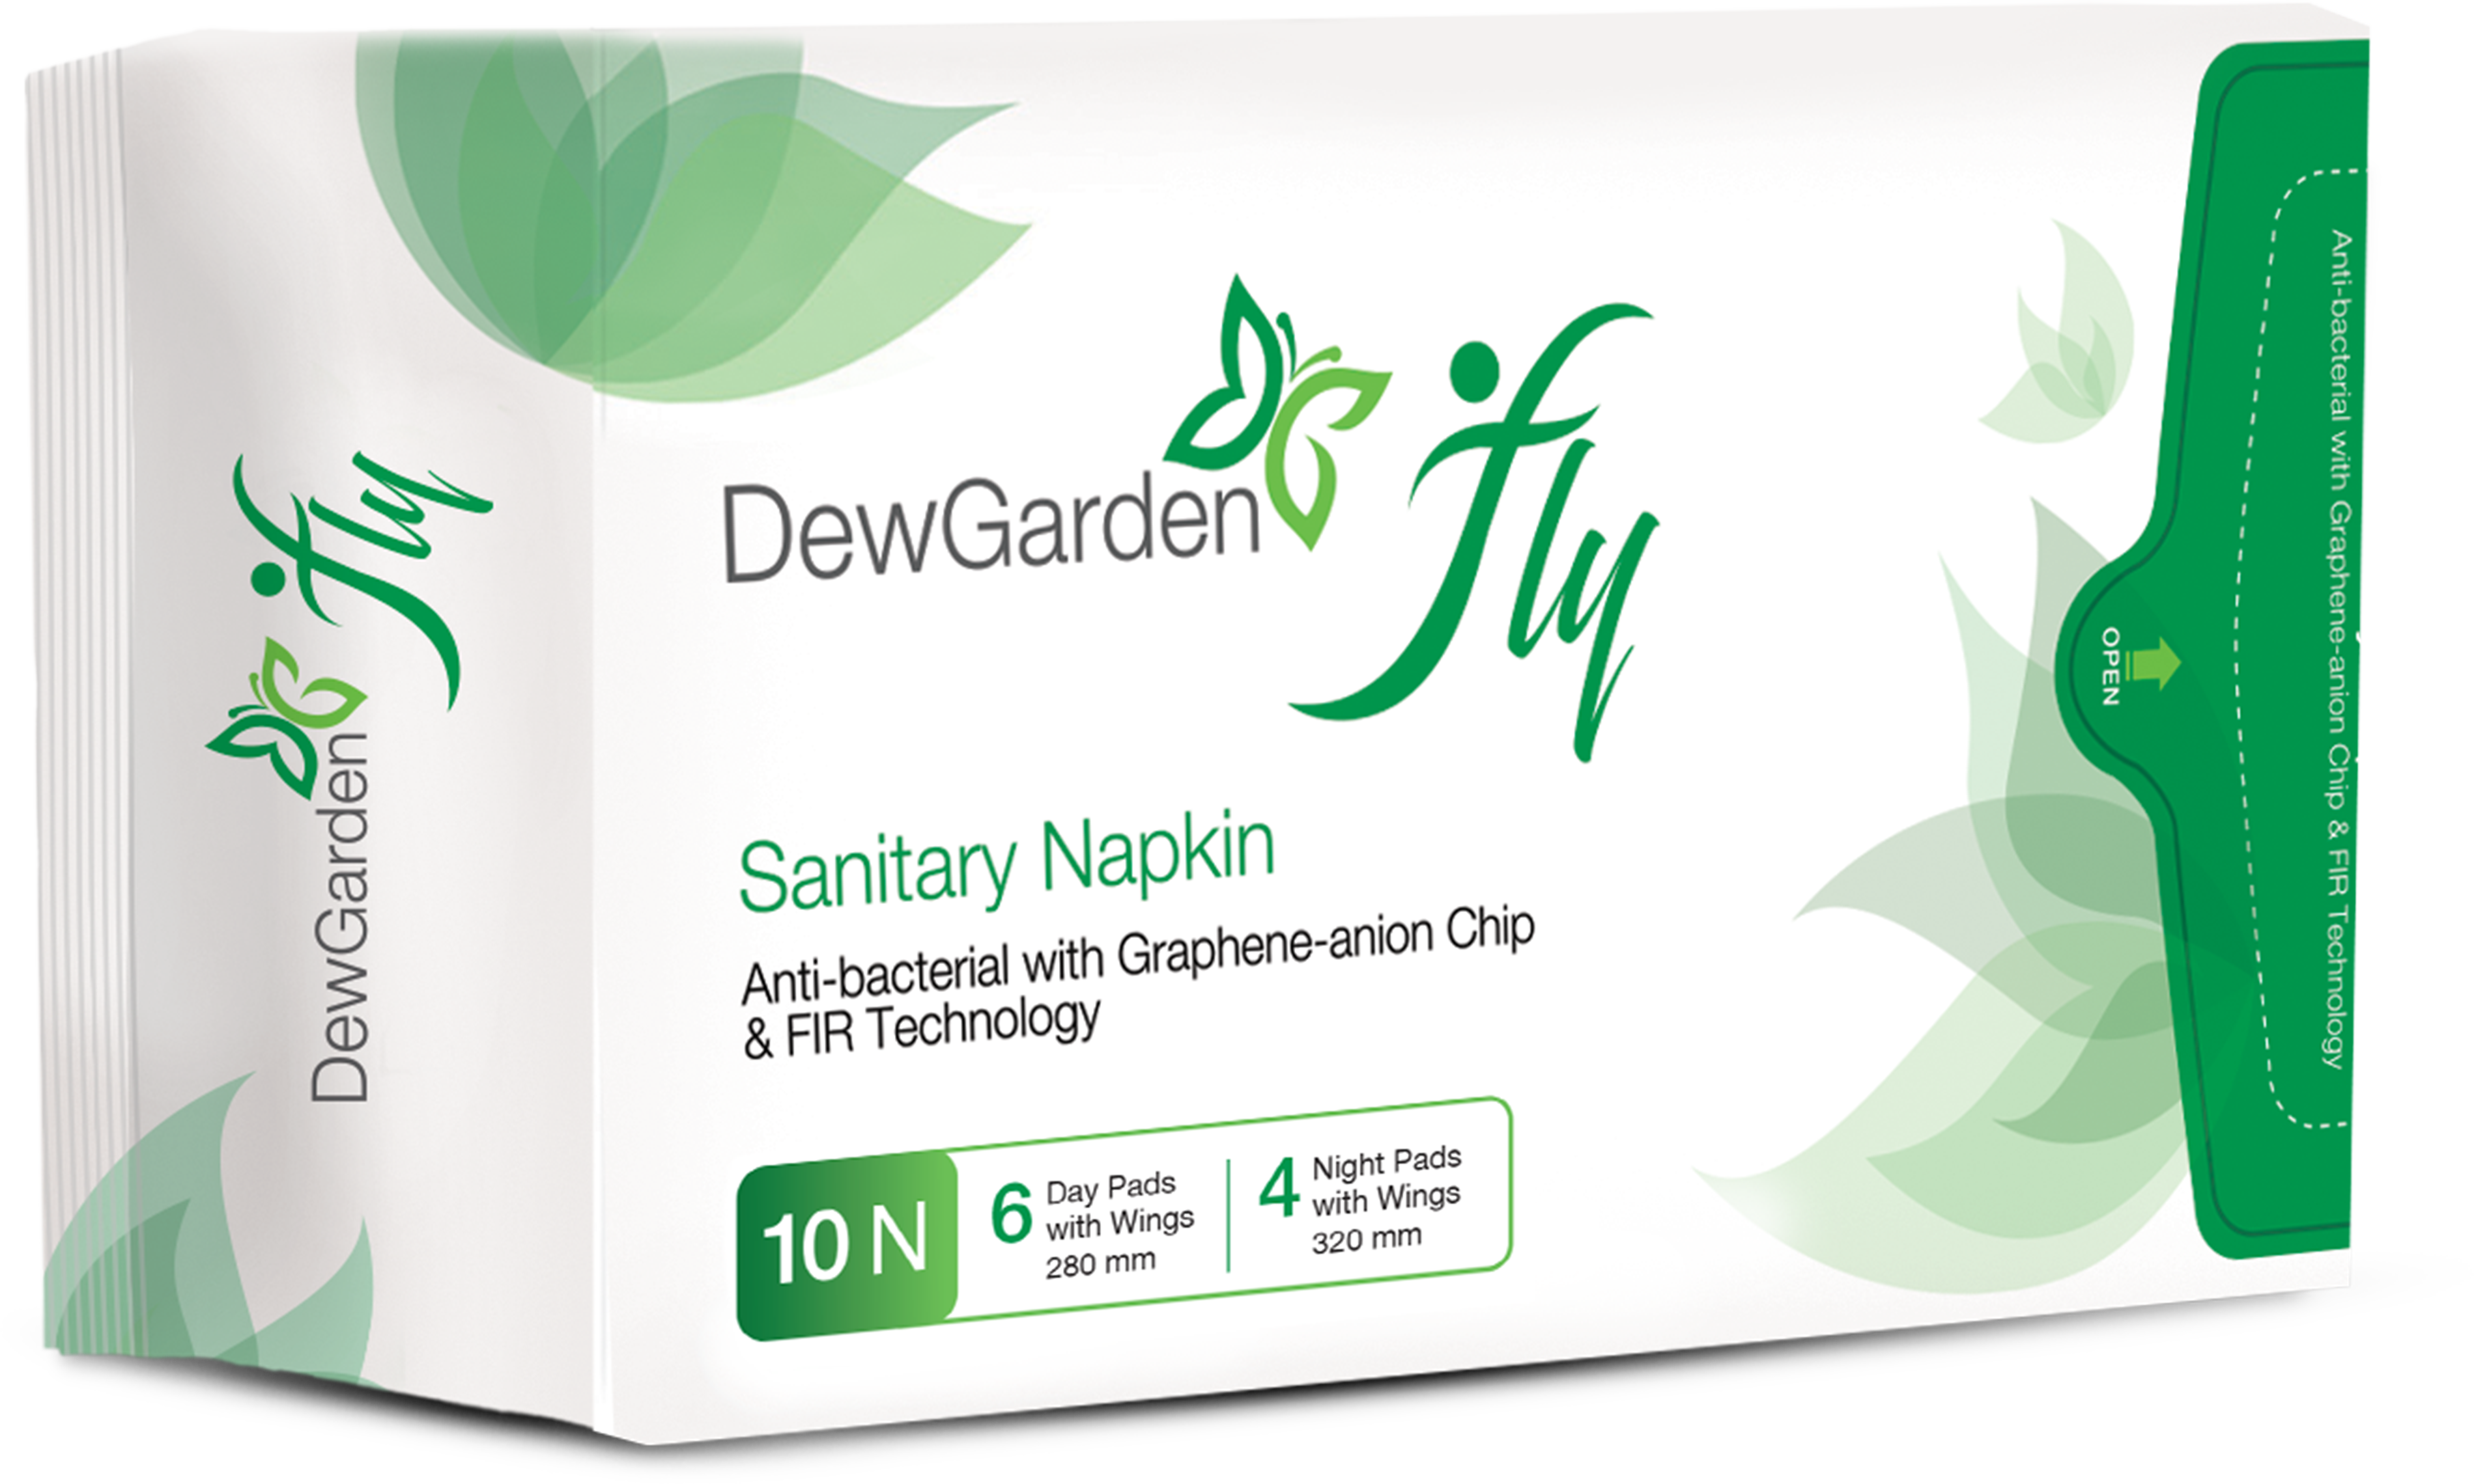
And that is why we knew we had to create something that gives you,
your power back.
It’s not just a product,
It’s a PROMISE
To support your confidence
everyday of the month

Slide 7
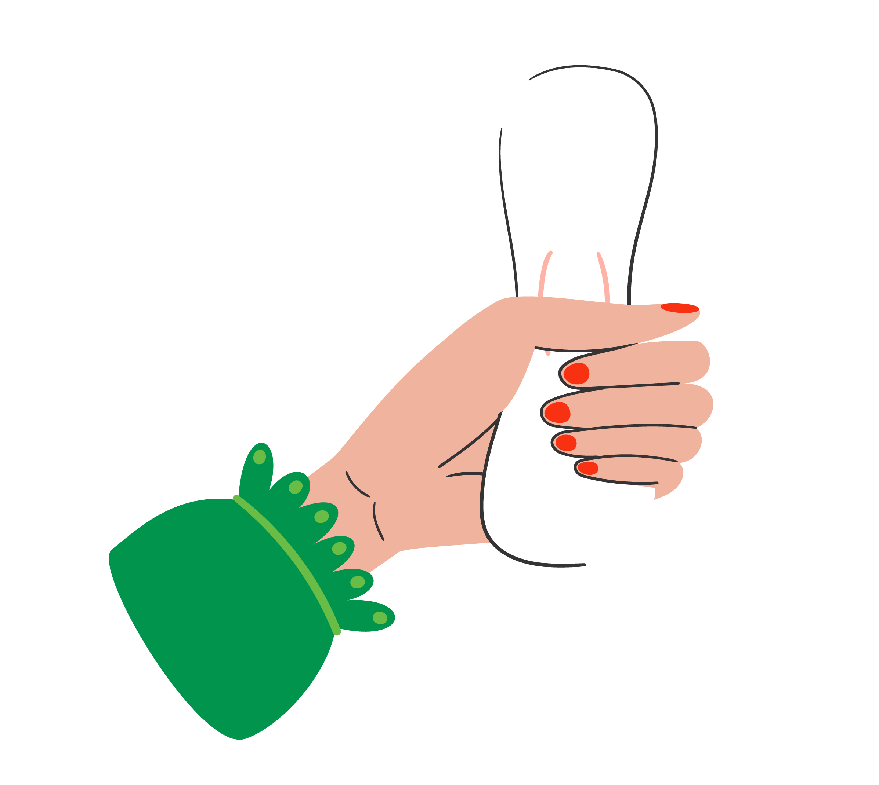
Soaps Are Sold More Than Napkins…
WHY?
Let’s break the taboo
Let’s Talk Period.
A topic long whispered, finally voiced loud!
Menstruation is natural, but comfort isn't universal…

Slide 8


Only 1 out of 3 menstruating women in India use napkins
with the fastest adoption in rural and Tier 2 and 3 cities.
113
2428

Slide 9



Over 10 Cr sanitary napkins
are being sold
in India, every month
In the next 3 years, the
consumption will double due to:-
Increased awareness
Government initiatives
Increased disposable income
Innovative/Customised products
Notes:
(https://www.walkthroughindia.com)

Slide 10
What’s wrong with current products?
70% of women have below unsolved concerns:
  Rashes - 60%
  Leakage - 45%
  Poor fit - 40%
Leading to frequent brand switching,
which means unmet needs.

Slide 11
From frustration to expectation
65% of women are actively exploring better options
Desired features:
Breathability & comfort - 58%
Rash-free - 51%
High absorption - 33%

Slide 12
At Vestige, we believe in solving your problems and not just selling products
Vestige – A Path To Empowerment
A way to transform you,
both personally and professionally
We Deliver Confidence With Financial Independence
Through Our Innovative & Need-Based Products.

Slide 13
On average, a woman spends around
₹500 - ₹1000 on personal hygiene every month
Notes:
(https://www.walkthroughindia.com)

Slide 14
Real Women, Real Results
Over 50% of Fast Start 8%
level achievers are women with
a business value of more than
INR 9,000
They are not just numbers, but stories of transformation.

Slide 15
Let’s drive Fast Start 8% with DewGarden
Include a minimum of 10 packs of DewGarden to achieve – Fast Start 8% level and drive the sale with confidence
Inspire all new women joiners in your team to repeat the same & simple, yet scalable process
It is achievable,
Because Napkins are an essential commodity product.

Slide 16

Confidence is the key to success in both personal and professional life
we say,
Fly With Confidence

Slide 17
Introducing DewGarden fly
Your everyday confidence
Built for every Indian woman’s real needs
Comfort, Care
and Confidence

Slide 18
With
we are committed to empowering
women, both as consumers
and entrepreneurs

Slide 19

Why?
Why?
GREEN
Represents freshness, nature and sustainability
DewGarden:
Inspired by nature’s purity, freshness and hydration— symbolising comfort
Evokes a sense of purity and well-being
Reinforces the product’s eco-friendly and safe materials
fly:
Represents freedom, lightness and confidence — how every woman should feel during her periods

Slide 20
More Than A Sanitary Napkin – A Hygiene Partner
Hygienic, antibacterial sanitary napkins
Embedded Graphene-Anion Chip for advanced protection
Prevents bacterial growth
Eliminates odour for all-day freshness
Reduces menstrual cramps
Promotes comfort and wellness
during periods

Slide 22
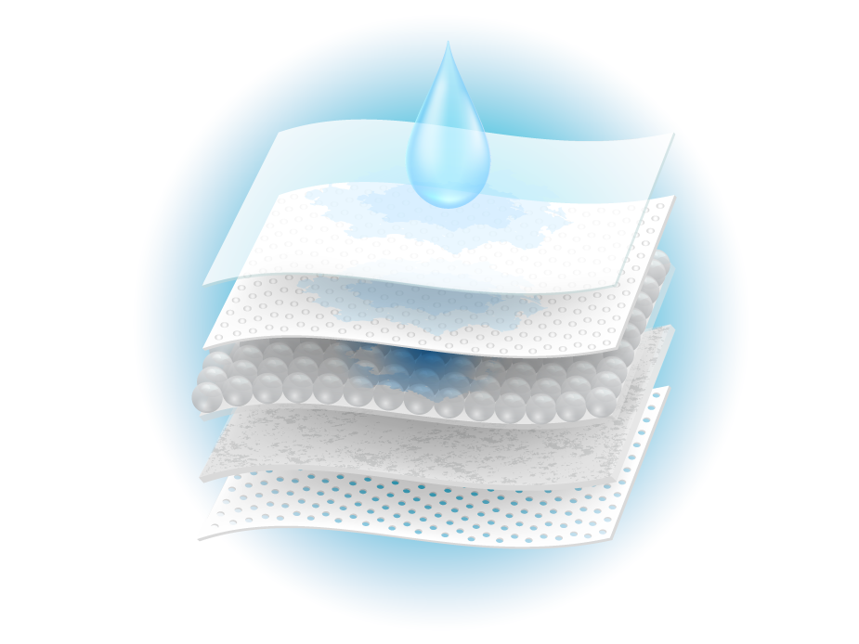
Graphene-Anion Chip & FIR Technology
Graphene is the top conductive material with high ion mobility, which helps prevent skin irritation.
It emits Far Infrared Rays (FIR) that boost cell activity and metabolism.
Far Infrared energy enhances blood circulation, supports women’s health, and may relieve menstrual discomfort.
Far Infrared is a natural energy, known as the
'birth light wave' by medical scientists.

Slide 23

Let’s Understand – What Are Anions?
Anions are nature’s healing ions, commonly found in forests and waterfalls, helping us feel refreshed and energised.
The chip may help:-
Eliminate odour
Inhibit bacteria
Maintain hygiene
Generate oxygen
Ease menstrual cramps

Slide 24
Why

Slide 25
Comfort & Protection
Regular Sanitary Napkins:
Basic soft top layer (may cause friction or discomfort)
Standard side wings for basic leakage control
Basic absorbent material (may not hold heavy flow)
Usually designed for either day or night, not both
Cottony-soft top layer for a smooth, irritation-free feel
Protective wings with 360° air laid paper to prevent side and back leakage
Super absorbent polymer core for better fluid retention
Designed for both day and night use
Notes:
Why it matters: DewGarden fly gives you reliable protection, all-day comfort, and confidence in any situation.

Slide 26
Health, Hygiene & Skin Safety
Regular Sanitary Napkins:
No advanced antibacterial protection
Limited breathability that traps heat and moisture leads to rashes and infection
Regular glue (may contain harmful toxins)
No odour control features
Antibacterial layer with Graphene-Anion chip and FIR Technology
Breathable bottom layer to reduce heat, sweat, rash and infection risk
Non-toxic glue that is skin-friendly and safe for long-term use
Odour control for freshness and hygiene
Notes:
Why it matters: DewGarden fly supports better personal health, hygiene, and skin comfort.

Slide 27

Better value with a brand you trust – Vestige
Price Comparison:
Regular sanitary napkins cost around ₹7 - ₹12 (Retail) and ₹ 15- ₹18 (Direct Selling) per sanitary napkin, depending on different brands
DewGarden fly DP is ₹19 per sanitary napkin
Added Value from Vestige:
PV & BV benefits
Advanced features not found in regular sanitary napkins
Backed by Vestige, a trusted direct selling brand
High-quality product you can use and confidently recommend to others
Notes:
Why it matters: With DewGarden fly, you're not just getting a superior pad—you’re investing in your health and growing your Vestige business.

Slide 28


Features | Ordinary pads Stayfree, Sofy | Pads loaded with features Whisper, Nua | DewGarden fly
Super absorbent polymer
Cottony-soft, skin-friendly layer
360° air-laid paper wings
Non-toxic, skin-safe glue
Breathable bottom + Graphene-Anion Chip + FIR Tech
One pack for both day and night usage
Added PV BV Benefits
Average Price Per Napkin | (₹10 – ₹12) | (₹25 – ₹30) | (₹19 + PV & BV)

Slide 29

Join The Movement
Change your life
Create your success story
Lift others with your success story
Start with your first 10 packs today!

Slide 30


